Slide 1
WELCOME! We will begin at 12:30
Check your speakers are working.
You should be able to hear music.

Slide 2
The National HMO Network
AGM & CONFERENCE
May 2023

Slide 3
Introduction
Thanks for coming along
What is the National HMO Network?
Why do we do conferences?
Mo Talukder
Chair

Slide 4
Agenda
AGM & VOTING ON ACCOUNTS
ROBIN STEWART – LEGAL ROUND UP
QUESTIONS

Slide 5
For your information
CPD Certificates
Steering Group
November Conference
Please remain logged in and attentive during the session
Emailed to you within 24-48 hours.
Want to become part of the National HMO Network steering group?
Particular interest in anyone from local authorities.
Details at the end of the presentation.
Professional development including CPD
In person conference
Networking Coffee and Lunch breaks included Range of HMO topics covered
Discount code

Slide 6
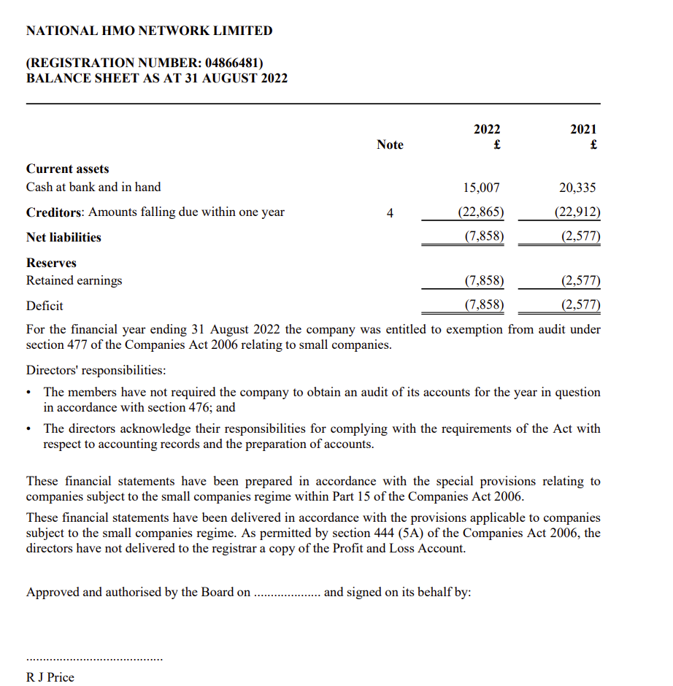
Accounts
y/e 31ST AUG 2022…

Slide 7
Do you accept the accounts just presented?
Yes
No
Abstain

Slide 8
Robin Stewart
Anthony Gold Solicitors LLP
Robin is a senior associate at Anthony Gold. He specialises in property litigation, especially landlord and tenant disputes, and the regulatory law relating to rented property.
Robin’s practice involves acting for landlords, tenants, property professionals, homeowners and businesses. Robin often acts in tribunal appeals, including appeals against improvement notices and prohibition orders, rent repayment order cases, and financial penalties under housing and consumer rights legislation.
Robin also advises on consumer law and trading standards and advises property professionals with updating their terms of business and tenancy agreements.

Slide 9
Legal Update: Renters Reform
ROBIN STEWART
ANTHONY GOLD SOLICITORS

Slide 10
The Renters (Reform) Bill
Abolition of section 21 notices and assured shorthold tenancies
Changes to grounds for possession
New right for landlords to give notice if they intend to sell
Changes to rent arrears grounds
Important other new grounds for possession
Significant changes to assured tenancies
All tenancies periodic
No more rent increase clauses
Statutory right for tenants to request pet
Private Rented Sector Ombudsman
Online portal/landlord’s database
Some new enforcement powers and a lead authority for enforcement

Slide 11
What is not in the Bill (but still promised by DLUHC on 17 May)
Improvements to court processes
“end-to-end digitisation of the process”
“explore the prioritisation of certain cases, including anti-social behaviour”
Decent Homes Standard in the private rented sector
Prohibiting blanket bans on renting to tenants in receipt of benefits or with children
Strengthening council enforcement powers

Slide 12
Also not in the bill
“Rent control”
Reversal of Rakusen v Jepson
Special treatment for student lettings market

Slide 13
Abolition of section 21 notices
Abolition of section 21 notice and assured shorthold tenancies
All ASTs become assured tenancies
Phased application of these changes
New tenancies
Existing tenancies
Tenancies where notice served & possession claim is proceeding

Slide 14
Changes to tenancies
Periodic only (no fixed terms)
Two month NTQ for tenants
No rent increase clauses
Section 13 notices will become more important
New requirement for a written statement of terms and other information
Replacement for How to Rent checklist
Specified contractual terms
Advance notice that landlord might recover possession based on particular grounds
Other information specified in regulations

Slide 15
Changes to grounds for possession
Major additions to the grounds, which the DLUHC say will be ‘comprehensive’
Amount of notice: 4 weeks rather than 2 for several important grounds
Failure to protect deposit stops service of s8 notice except for grounds 7A and ground 14 (nuisance and antisocial behaviour)
Full summary of proposals here: https://www.gov.uk/guidance/tenancy-reform-renters-reform-bill

Slide 16
New Ground 1 – property required for family member

Slide 17
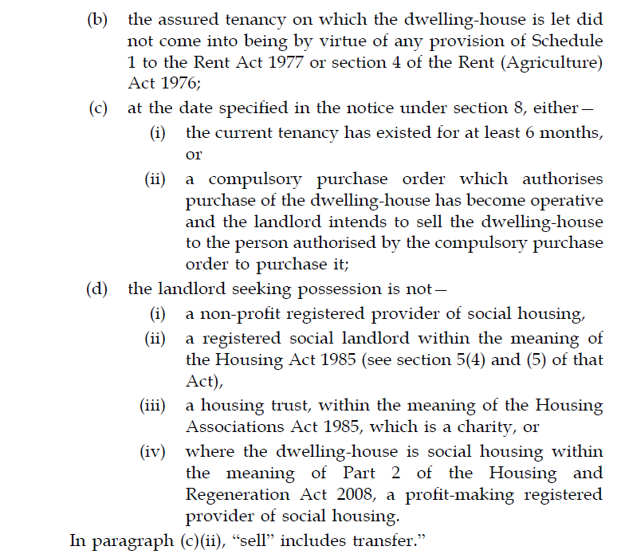
Ground 1A – Landlord intends to sell

Slide 18
Three month waiting period before landlord may re-let

Slide 19
New Ground 5C – employees of landlord

Slide 20
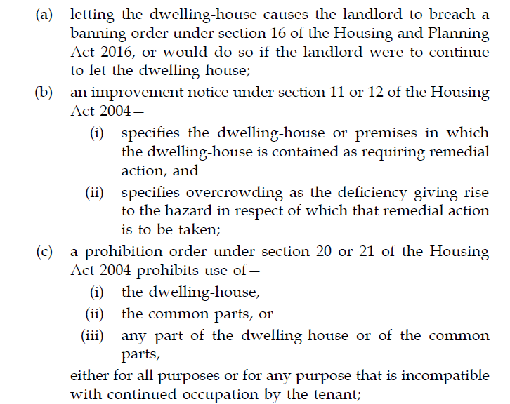
New Ground 6A – compliance with enforcement action

Slide 21
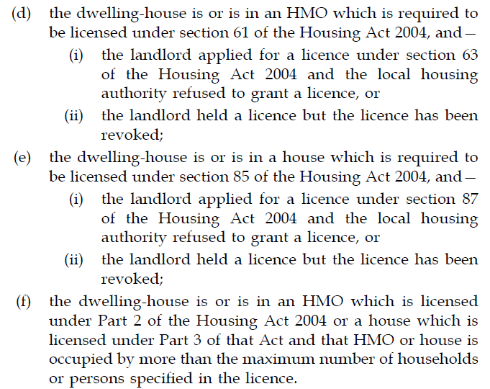
New Ground 6A – compliance with enforcement action

Slide 22
Amendment to Ground 8 – arrears caused by UC delays

Slide 23
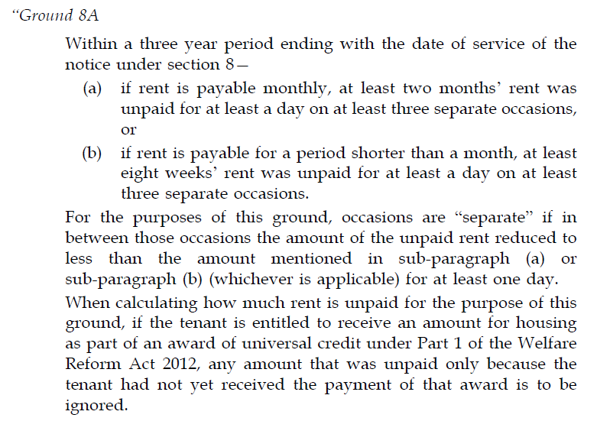
New Ground 8A – three separate instances of high arrears

Slide 24
Amended Ground 14 – conduct ‘capable of causing’ nuisance or annoyance

Slide 25
Online portal / Landlord Database
Landlord entries
Dwelling entries
Must have active entries to market or let properties
Other details contained on the database
Enforcement of duties

Slide 26
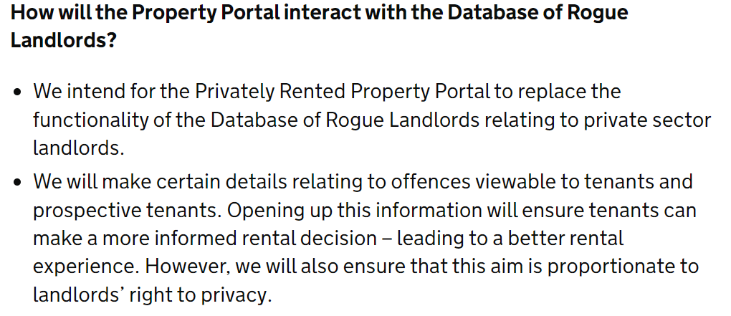
Online portal / Landlord Database

Slide 27
Online portal / Landlord Database

Slide 28
Landlord redress scheme
Power for Secretary of State to make regulations creating duty for a residential landlord to be a member of an approved redress scheme
Regulations will set out detail of how scheme will operate including:
Timescales
Data sharing
Fees
Expulsion
Powers of redress
Fine for landlords who do not join
Decisions can be enforced like court orders

Slide 29
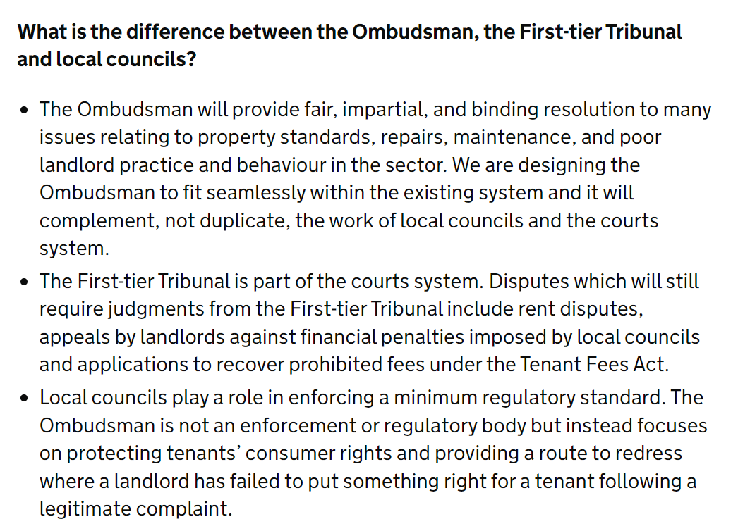
Landlord redress scheme

Slide 30
Right to request pets
New implied contractual term that:
A tenant may keep a pet at the dwelling-house if the tenant makes a request and the landlord consents;
Requests must be in writing and give a description of pet;
Consent is not to be unreasonably refused by the landlord;
Landlord is to give or refuse consent in writing on or before the 42nd day after the date of the request, with extensions in certain circumstances.
Landlords can refuse because superior landlord will not allow pets
Landlord can require tenant to obtain or pay cost for insurance against pet damage
Tenant Fees Act is amended to allow this

Slide 31
Definition of pet
“pet” means an animal kept by a person mainly for—
(a) personal interest,
(b) companionship,
(c) ornamental purposes, or
(d) any combination of paragraphs (a) to (c);

Slide 32
Pets and Landlord Redress Scheme in practice
What can tenant do if landlord unreasonably refuses to allow pet?
Get one anyway
Court proceedings
Landlord redress scheme?

Slide 33
What next for the Bill?
Second reading and then committee stage in Parliament
Expect amendments:
Government to add missing provisions?
Weakening of some grounds?
Fixing some weaknesses and loopholes
Lots of the detail will be contained in regulations to be made by ministers
In force by…?
Gradual application to existing ASTs

Slide 34
Government guidance on implementation

Slide 35
Questions
Contact Robin Stewart
Anthony Gold Solicitors LLP
Tel: 020 7940 4060
E: robin.stewart@anthonygold.co.uk

Slide 36
November Conference
Normally £149.00
Now £79.00
£70 OFF until the end of May.
Discount Code: AGMATTENDEE

Slide 37
Become a steering group member
https://nationalhmonetwork.com/join-the-steering-group/

Slide 38
Thank you!

